Slide 1
UNIT 2 ENERGY CONSERVATION IN THERMAL SYSTEMS
By
Dr. N. Dilip Raja, Ph.D.

Slide 2
INTRODUCTION TO THERMODYNAMICS
Thermodynamic definition of a system
A closed region in space or a physical body on which an experiment is carried out
Types of thermodynamic system
Open system: Energy transfer and mass transfer take place. Eg: Automobile engine, cycle pump, water heated in an open beaker, flute, etc.
Closed system: Energy transfer takes place but mass transfer do not take place. Eg: pressure cooker, inflated gas balloon, bomb calorimeter, etc.
Isolated system: Neither energy transfer nor mass transfer takes place. Eg: Flask, universe
Steam system
A thermodynamic system that uses steam as the working fluid.

Slide 3
IMPORTANT TERMS IN THERMODYNAMICS
System: Region in space or body on which experiment is carried out
Properties: Measurable quantity. Eg: pressure, temperature, time, velocity, density, etc.
State: Properties having definite value at given time
Process: Change of state of system
Cycle: Series of processes having same state at the beginning and end
Equilibrium: Constant change of state in a system

Slide 4
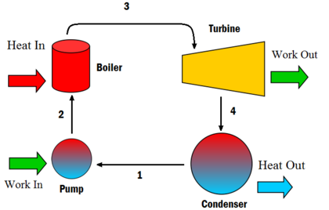
STEAM SYSTEM
Steam system having steam as the working fluid
Obeys Rankine cycle
Obeys law of conservation of energy
RANKINE CYCLE

Slide 5
BOILERS
Classifications
Based on applications: domestic boilers, commercial boilers, locomotive boilers, power plant boilers
Based on applied pressure: Low pressure boiler (1 bar), medium pressure boiler (1 to 10 bar), high pressure boiler (>10 bar)
Based on capacity: Non-IBR boiler (<25 l), IBR boiler (>25 l)
Based on construction: Water tube boiler, Fire tube boiler

Slide 6
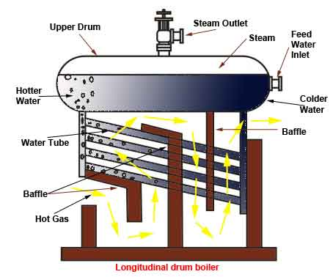
WATER TUBE BOILERS

Slide 7
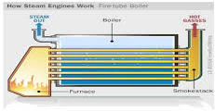
FIRE TUBE BOILERS

Slide 8
BOILER MOUNTINGS
Used to improve safety in operation of the boilers
Pressure gauge
Steam stop valve
Safety valve
Water level indicator
Feed check valve
Blow off valve
Fusible plug

Slide 9
BOILER accessories
Used to improve efficiency of the boiler
Feed pump
Super heater
Economizer
Air preheater

